Slide 1
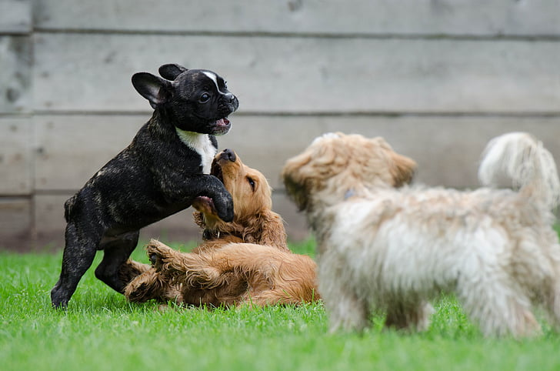
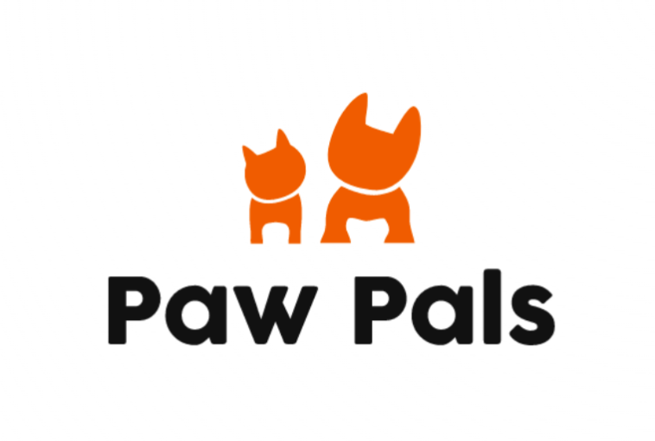
Paw Pals
Stephen, Brent, Ian, Sara
Notes:
Total time 12 mins max, 7 mins minimum

Slide 2
Project Description
Purpose
A digital space that allows dog owners (targeted users) to create profiles for their dogs, detailing their characteristics, tendencies, and personalities. Facilitates communication with other profiles that are matched based on location and preferences. Allowing them to set up playdates.
Paw Pals exists to ensure that your dog is safe and always has other dogs to be best friends with and not interact with dogs that may be aggressive and cause trauma to your dog.
Notes:
stephen speaks / Brent speaks

Slide 3
Technical Platforms
Frontend - React (HTML/CSS)
Backend - Node.js / Express
Database - MySQL
Notes:
Brent speaks

Slide 4
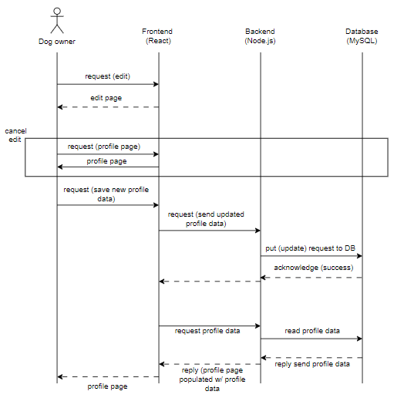
UML Sequence Diagram - Update Profile
Notes:
Brent speaks

Slide 5
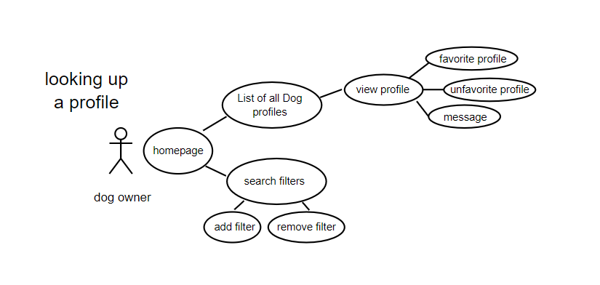
UML Use case 1 - looking up profile
Notes:
Ian Speaks

Slide 6
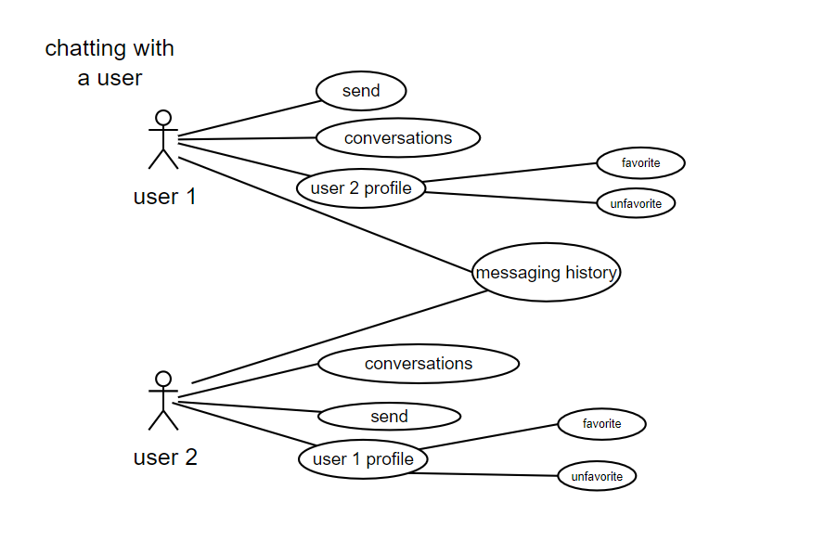
UML Use case 2 - chatting with user
Notes:
Ian speaks

Slide 7
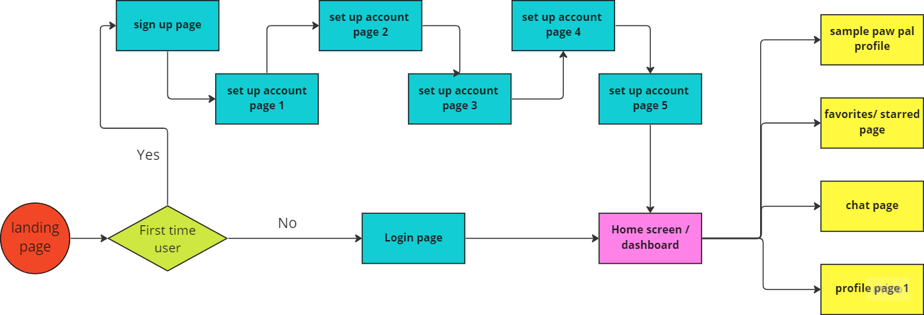
Process Flow of HTML pages
Notes:
Ian Speaks

Slide 8
HTML Demo
Notes:
Stephen speaks

Slide 9
Questions?
Comments?
Feedback?
Thank you

